Slide 1
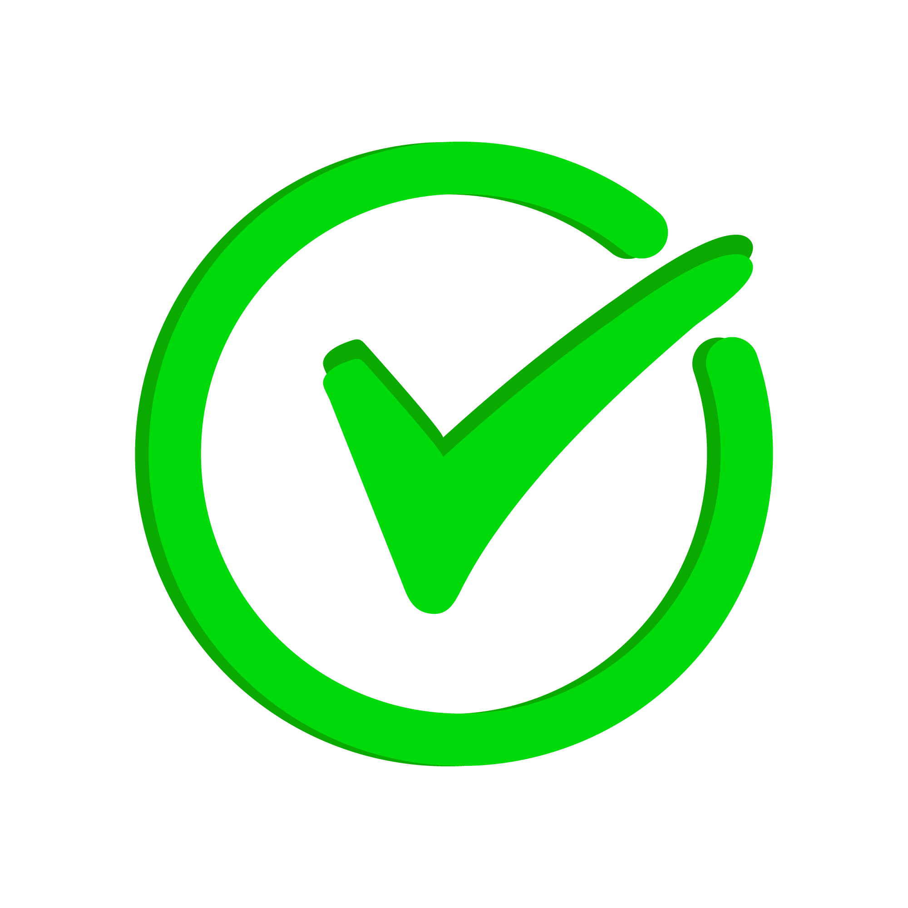
DO IT: Todo App
By: The CS Guys
Names: Akash Sukumaran, Alejandro Castillo, Nathan Le, Tomas Odio, and Kesh Reddy

Slide 2

Problem Statement
Software engineers face challenges in managing multiple tasks effectively.
Existing to-do apps fail to address developer-specific needs like task integration, sprint tracking, and technical debt management.
Without tailored solutions, task organization and productivity are hindered.
Todo:
Talk to Bob
Help Catherine
Work on app
Talk to someone else I forgot…
Notes:
Kesh: Software engineers often face the challenge of juggling multiple responsibilities simultaneously, such as coding, reviewing pull requests, addressing technical debt, and managing sprint deadlines. The tools available today are great for general task management but don’t meet the specific needs of developers. These apps lack features like sprint tracking, seamless integration with developer tools, and support for technical workflows, which are critical for organizing work efficiently. This slows down task tracking, making it harder for engineers to focus on what truly matters. Recognizing these shortcomings, our team identified a clear gap: the need for a task management app designed specifically for developers. Our solution, DO IT, addresses this gap by providing tools tailored to the unique workflows and challenges faced by software engineers.

Slide 3
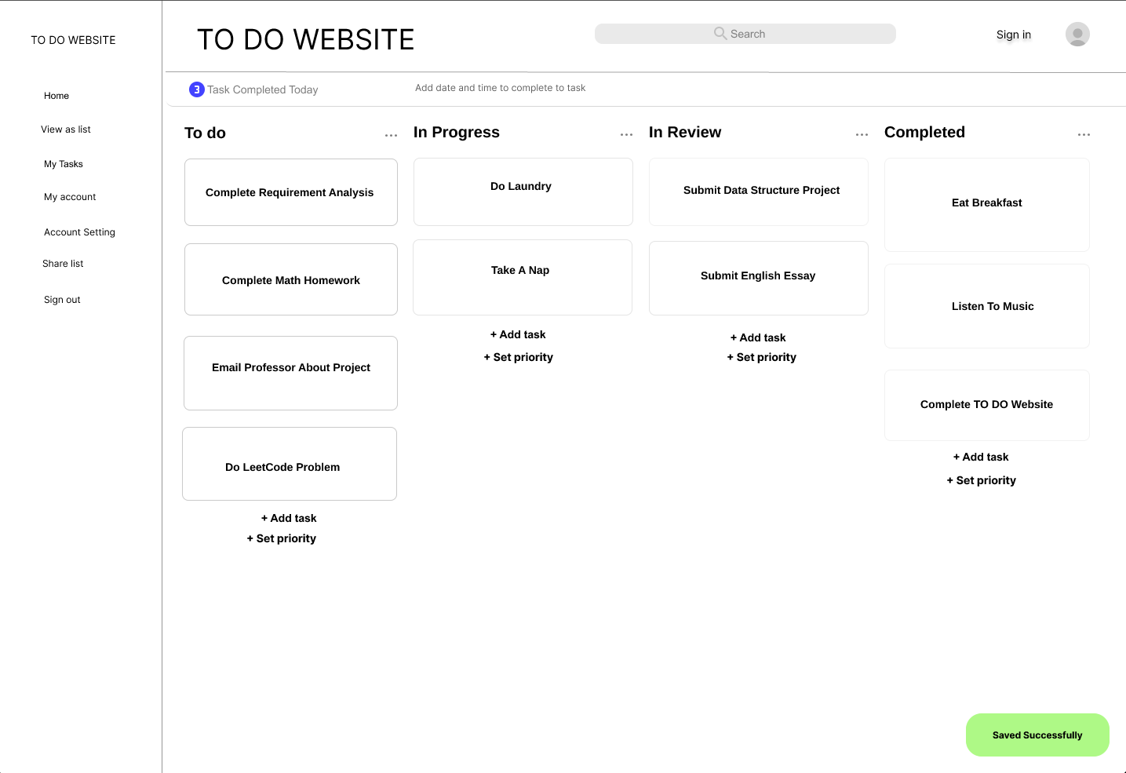
Our Solution
DO IT is a task management app designed specifically for software engineers.
Features include task creation, prioritization, sprint tracking, and notification reminders.
Seamless integration with tools like GitHub to support agile workflows.
Notes:
Kesh: Our solution to the problem is DO IT, a task management app specifically tailored to software engineers. Unlike generic task managers, DO IT is designed with features that directly address the pain points we discussed earlier. The app allows users to create, organize, and prioritize tasks seamlessly, supporting key developer workflows like sprint tracking and deadline management. With notification reminders, DO IT ensures that important deadlines are never missed. Additionally, the app integrates seamlessly with popular developer tools like GitHub, making it easy for users to manage their tasks without disrupting their workflow. By focusing on features that developers actually need, DO IT transforms task management from a frustrating chore into an efficient and intuitive process.

Slide 4
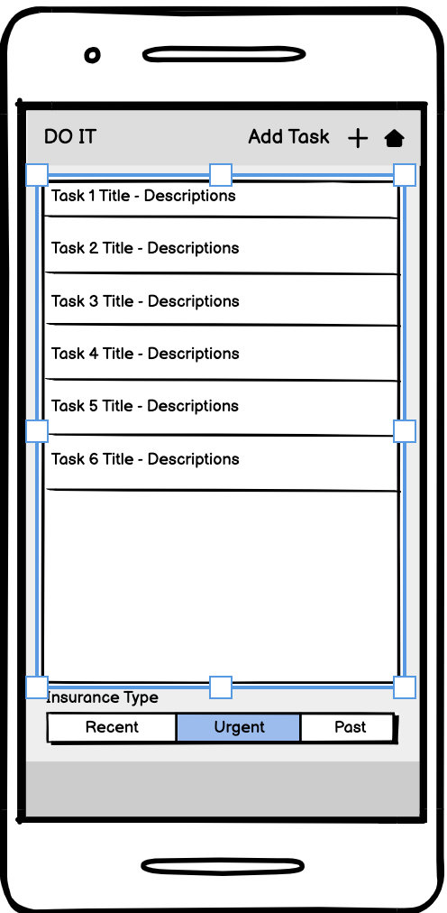
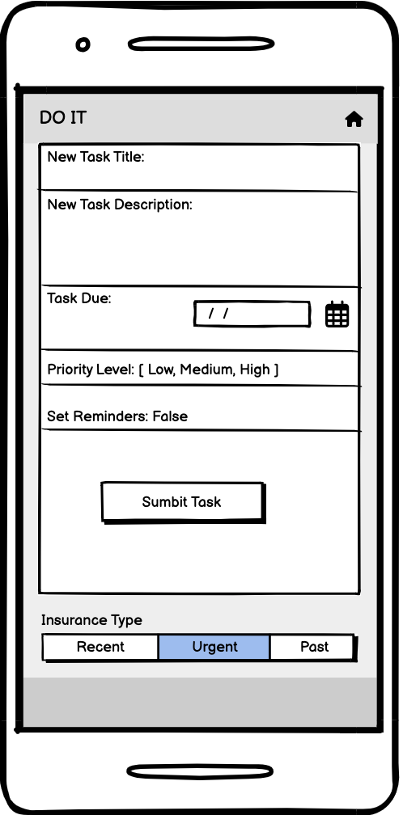
Use Case 1: Create a new task with deadlines and priorities
From home navigate to the todo list.
Click the ‘Add Task +’ in the top right corner.
New page pops up to fill in required information to create a new task.
Submit Task
Notes:
Tomas

Slide 5
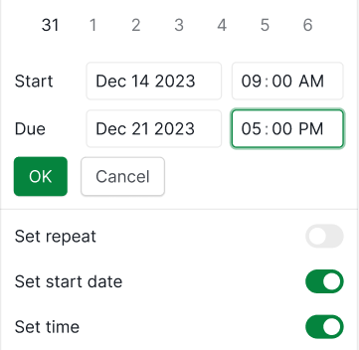
Use Case 2: Set reminders for task deadlines to stay on track
User selects a task and chooses to set a reminder
The app prompts the user to input the reminder time and notification settings
The system schedules the reminder in app
The app notifies the user at the specified time
Notes:
Tomas

Slide 6
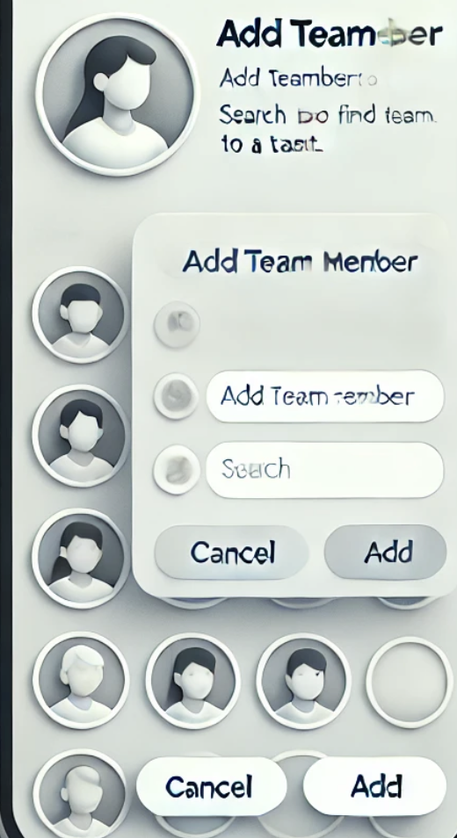
Use Case 3: Collaborate with team members and track progress
User selects a task
User selects the add button to add a team member to the task
The system adds the task to the other team member
The system now shows two members on the task
Notes:
Tomas

Slide 7
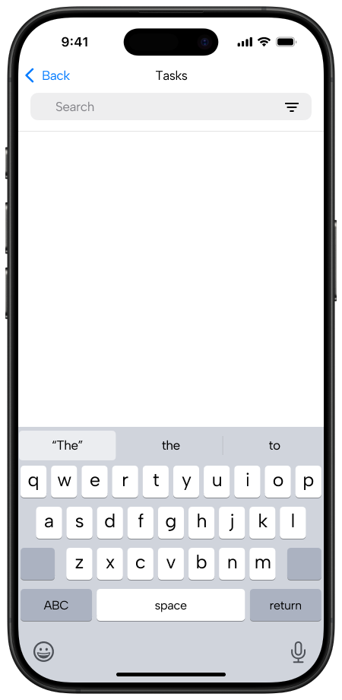
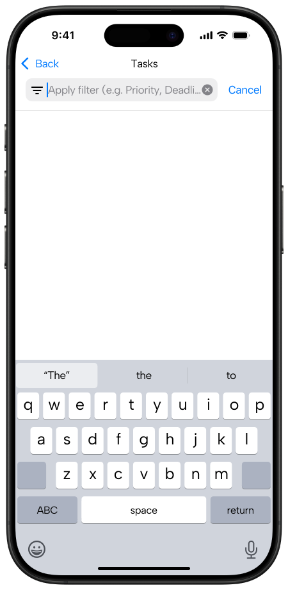
Use Case 4: Search for tasks using filters (e.g., priority, project)
User enters search criteria such as due date, priority, or tags.
The app sends a query to the database using the provided filters.
The database returns a list of matching tasks to the app.
The app displays the filtered tasks to the user.
Notes:
Tomas

Slide 8
Key Requirements
Functional Requirements:
Create, update, and delete tasks with descriptions, priorities, and deadlines.
Set notifications and reminders for tasks.
Allow collaboration, such as assigning tasks to team members and tracking progress.
Provide search and filtering features by project, priority, or due date.
Non-Functional Requirements:
Usability: Intuitive interface for quick learning.
Performance: Dashboards must load within 3 seconds, even with 500 tasks.
Scalability: Support for 1,000 active users in real-time.
Reliability: Ensure 99.9% uptime for uninterrupted access.
Notes:
Akash: To implement the features and use cases we’ve discussed, we defined a set of both functional and non-functional requirements for DO IT. Functionally, the app must allow users to create, update, and delete tasks efficiently, complete with descriptions, priorities, and deadlines. Users should also be able to set reminders and notifications for their tasks, ensuring they stay on track. Collaboration is another key feature, enabling team members to share tasks, update progress, and communicate effectively. Finally, robust search and filtering options help users locate tasks quickly based on project, priority, or due date.
On the non-functional side, we prioritized usability, designing an intuitive interface that users can learn in under 30 minutes. Performance is also critical—dashboards must load quickly, even with a large number of tasks. Scalability ensures the app can support hundreds of active users working collaboratively in real-time without performance loss. Reliability and security are non-negotiable; we would aim for 99.9% uptime and encrypted data storage to protect user information. These requirements form the foundation of a reliable and user-friendly application.

Slide 9
High-Level and Low-Level Design
High-Level Design:
Event-driven architecture chosen for responsiveness and reusability.
Example: Clicking "Add Task" triggers an event to open the task creation dialog.
Low-Level Design:
Observer pattern used for task notifications.
Allows multiple notification channels (e.g., email, push notifications) to stay synchronized with task updates.
Notes:
Akash: The system design for DO IT focuses on simplicity, flexibility, and responsiveness. At a high level, we opted for an event-driven architecture. This approach allows user interactions, such as clicking the 'Add Task' button, to trigger events that open relevant dialogs or update task data. This design not only simplifies interactions but also ensures reusability of components and events as the app grows.
For the low-level design, we implemented the Observer pattern to handle task notifications. This pattern establishes a one-to-many relationship between tasks and notification channels. For example, when a task's due date changes, the system can notify all registered channels, such as email or in-app notifications, without tightly coupling the task logic to the notification mechanism. This decoupling improves maintainability and makes it easy to add or modify notification methods in the future.
Together, these design choices ensure DO IT is scalable, extensible, and user-friendly.

Slide 10
Design Sketches
Clean, intuitive layout prioritizes ease of navigation and task input.
Key UI elements include:
Task board with drag-and-drop functionality.
Quick-access buttons for adding tasks, filtering, and sorting.
Notification reminders displayed as subtle pop-ups.
Personalization options, such as customizable views and color-coded categories.
Notes:
Akash: Our design prioritizes intuitive navigation and simplicity, ensuring that users can manage their tasks without feeling overwhelmed. The task board is the centerpiece of the interface, allowing developers to view, organize, and prioritize tasks using drag-and-drop functionality. Quick-access buttons for adding tasks, filtering, and sorting make it easy to update and view tasks with minimal effort.
Notifications are displayed as non-intrusive pop-ups, keeping users informed without disrupting their workflow. To enhance usability, we included personalization options, like customizable views and color-coded task categories, to fit individual preferences. For example, users can toggle between a detailed view of task progress or a simplified list of priorities.
These highlight our emphasis on clean design and user engagement. The layout ensures a logical progression, from adding tasks to monitoring their completion, all while keeping cognitive load low.

Slide 11
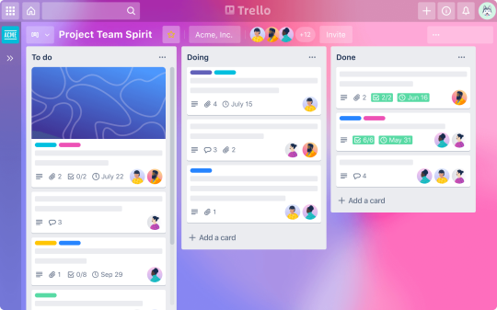
Existing Solutions and Research
Popular task management tools like Jira, Trello, and Notion are effective but lack developer-specific features.
Research on developer productivity highlights the need for tools tailored to agile workflows and sprint management.
DO IT bridges this gap with developer-centric features like sprint integration, technical debt tracking, and collaboration tools.
Notes:
Nathan: When developing DO IT, we analyzed popular task management tools such as Jira, Trello, and Notion to identify their strengths and limitations. While these tools are widely used, they’re designed for general-purpose task management or large teams, not specifically for software engineers. For example, they don’t offer seamless integration with technical workflows or address sprint-based task organization effectively.
Research in developer productivity emphasizes the need for tools that align with agile methodologies and support features like sprint management, prioritization, and technical debt tracking. This gap in current tools inspired DO IT, which focuses exclusively on meeting the needs of software engineers.
What sets DO IT apart is its developer-centric approach. Features like integration with GitHub and real-time collaboration capabilities make it a unique solution that bridges the gap between traditional task management and the demands of modern software development.

Slide 12
Software Engineering Process
Prototyping Model: Chosen for flexibility and iterative feedback.
Steps:
Requirements Elicitation: Interviews and surveys to gather user needs.
Prototyping: Created sketches and mockups to visualize features.
Feedback Loop: Incorporated feedback from stakeholders to refine designs.
Benefits:
Rapid adjustments based on user input.
Cost-effective, iterative approach.
Notes:
Nathan: For the development of DO IT, we followed the prototyping model of software engineering. This model was ideal because it allowed us to gather feedback at every stage and make iterative improvements without committing excessive resources to a fully developed product early on.
We started with requirements elicitation by interviewing and surveying software engineering students to identify key features they needed, such as sprint tracking, notifications, and task prioritization. Based on these insights, we created prototypes, including design sketches and mockups, to visualize how the app would look and function.
Feedback from stakeholders played a critical role in refining our prototypes. For instance, user input helped us prioritize features like drag-and-drop functionality and customizable notifications. The prototyping model enabled us to iterate quickly and efficiently, ensuring that the final design aligned with user expectations.

Slide 13
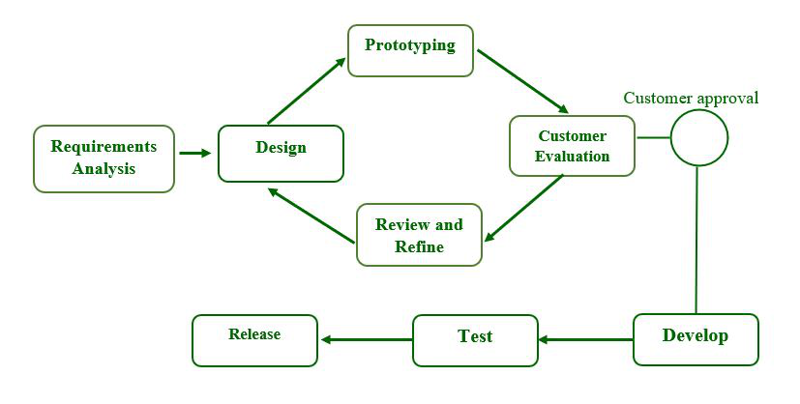
What we learned
The importance of iterative prototyping for aligning with user needs.
Effective communication and collaboration within a team lead to better designs.
Applying design principles like modularity and user-centered design enhanced usability.
Leveraging tools like the Observer pattern and event-driven architecture improved system scalability and maintainability.
Notes:
Alejandro: Through this project, we gained valuable insights into the software development process. One of the biggest lessons was the importance of iterative prototyping. Gathering feedback early and often allowed us to align our app's features with the actual needs of users, ensuring its relevance and usability.
We also learned the value of effective communication and collaboration within our team. Whether brainstorming ideas, refining mockups, or incorporating stakeholder feedback, teamwork played a crucial role in shaping our project.
From a technical perspective, we applied important design principles like modularity and user-centered design, which enhanced the app’s usability and simplicity. For example, focusing on clean, intuitive navigation made our interface easier for users to adopt.
Finally, implementing system design patterns like the Observer pattern for task notifications and an event-driven architecture taught us how to build scalable and maintainable systems. These approaches will be invaluable in our future development projects.

Slide 14
Future Enhancements
AI Integration: Add AI-powered task prioritization and recommendation features.
Cloud Synchronization: Enable multi-device support for seamless task management.
Advanced Analytics: Provide detailed productivity reports and insights for users.
Enhanced Collaboration: Introduce features like real-time task updates and shared dashboards.
Notes:
Alejandro: Looking ahead, there are several ways we can enhance DO IT to further meet the needs of software engineers. First, we envision integrating AI-powered task prioritization to help users identify their most critical tasks automatically. AI could also provide personalized task recommendations based on past behavior or project deadlines.
Another key enhancement is cloud synchronization. This would allow users to seamlessly access their tasks across multiple devices, ensuring continuity and convenience no matter where they’re working.
We also plan to introduce advanced analytics, providing users with detailed productivity reports and insights to help them improve their workflow and time management. For example, users could track their task completion rates or identify bottlenecks in their workflow.
Finally, enhanced collaboration features, such as real-time task updates and shared dashboards, would make DO IT even more effective for team environments. These features align with our vision of creating a comprehensive task management tool that evolves alongside the needs of developers.

Slide 15
Thank you!
Any Questions?

